Slide 1


MIT College of Engineering
Department of Information Technology
Project Based Seminar (Oral) Presentation
On
Peer to Peer Communication
By
T150388606 Neeraj Lagwankar
Guide
Prof. Shamla Mantri
Day and Date of Exam : Friday, 20 April 2018

Slide 2
Contents
Project Group
Introduction
Literature Survey
Peer-to-Peer Communication
Applications/advantages
Conclusions
References

Slide 3
Project Details
Project Title : Document Sharing Based on Decentralized File System
Project Domain: Blockchain Implementation
Project Group Members:
  T150388606 , Neeraj Lagwankar
  T150388594 , Kishlaya Kunj
  T150388574 , Ishan Joshi

Slide 4
Peer to Peer Technology

Slide 5

History
Before Peer to Peer (P2P) network was implemented, a more simple architecture was used in the form of Client Server architecture.
Eg: A web server serves web pages and a file server serves computer files

Slide 6
Disadvantages
Number of clients are much higher than number of servers.
Unable to serve large number of clients due to traffic congestion.
High work load on server.
High latency.

Slide 7
Solution
Peer to Peer (P2P) Networking.

Slide 8
What is P2P?
What is P2P?
Peer to Peer is communication between peers without the intervention of a server.
Peer
Peer
Peer
Peer
Peer to Peer Communication
7

Slide 9
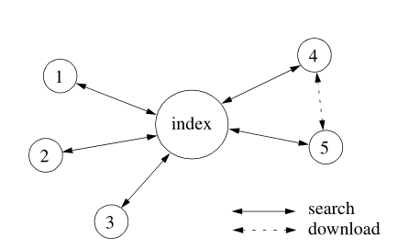
Algorithms
Centralized directory model:
            This model was made popular by Napster. The peers of the community connect to a central directory where they publish information about the content they offer for sharing.

Slide 10
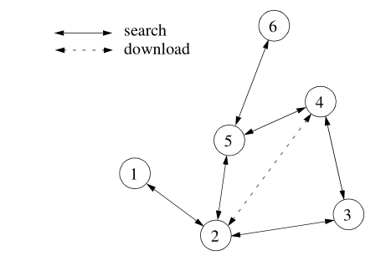
Algorithms
Flooded Request Model:
            This is a pure P2P model in which each request from a peer is flooded (broadcast) to directly connected peers until the request is answered or a maximum number of flooding steps (typically 5 to 9)

Slide 11
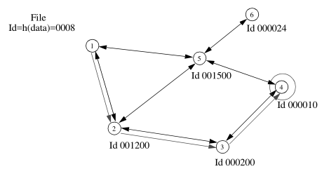
Algorithms
Document Routing Model:
            The document routing model, is the most recent approach. Each peer from the network is assigned a random ID and each peer also knows a given number of peers.
Seminar Title Goes here

Slide 12
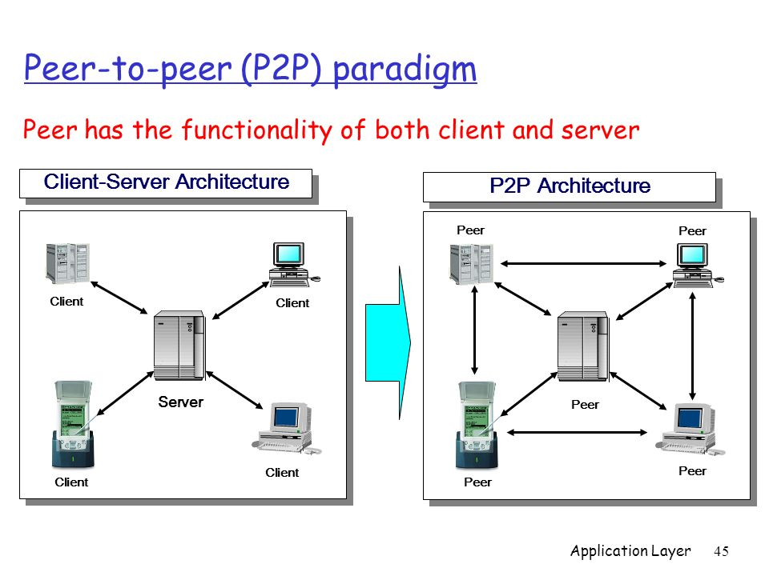
Advantages
Each peer acts as a client as well as a server. Due to this, there is minimum load.
Server is not present in P2P, which results in increased speed, reliability, reduced latency and maximum efficiency.

Slide 13



Applications
Cryptocurrency:
          Cryptocurrencies like Bitcoin, Ethereum, Litecoin, etc are based on blockchain which is a well known application of P2P technology.

Slide 14
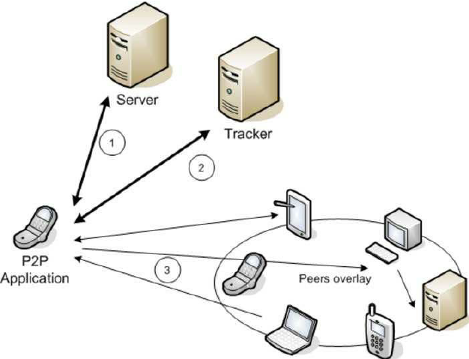


Applications
Communication:
          The P2P model covers a wide spectrum of communication paradigms.
Group Management:
          Peer group management includes discovery of other peers in the community and location and routing between those peers.

Slide 15


Applications

Slide 16
Our Implementation
We will be using this decentralized network to share official documents amongst peers allowing them to access the files instantly without worrying about server crash or low bandwidth problems.

Slide 17
Conclusion
In this seminar, we studied the different advantages of P2P Networking and its different application which will help in better communication amongst users.
Due to robustness and security of P2P Networking, it can be used to develop secure transaction systems.

Slide 18
References
[1] Decentralised, Dynamic Network Path Selection in High Performance Computing: John Anderson, Matt Piazza, Aspen Olmsted, 2016
[2] “Peer-to-Peer Streaming Peer Protocol (PPSPP),”: A. Bakker, R. Petrocco, and V. Grishchenko, RFC 7574, Jul. 2015.
[3] Peer to Peer Computing: Dejan S. Milojicic, Vana Kalogeraki, Rajan Lukose, Kiran Nagaraja, Jim Pruyne, Bruno Richard, Sami Rollins, Zhichen Xu, 2002

Slide 19
Thank You!

